Slide 1

Name: Eashwar M department: da_ds Batch: March_2025 date: 10-06-2025
Reinforcement Power Bi Project

Slide 2
Project Objective
The objective of this project is to design and develop an interactive and visually insightful dashboard using Power BI to reinforce learning in data analysis and business intelligence.
The dashboard will integrate data from various sources, apply data cleaning and transformation techniques using Power Query and DAX, and present key performance indicators (KPIs) through intuitive visualizations.

Slide 3
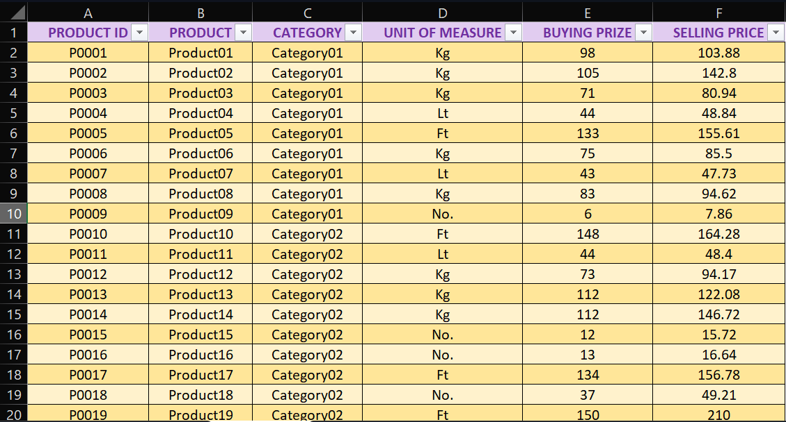
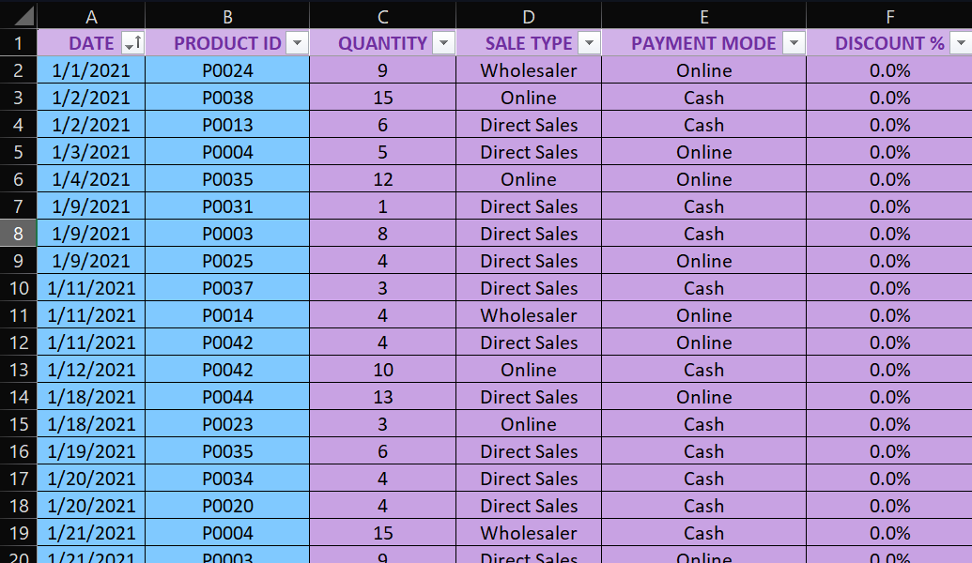
Dataset overview
Input data Master Data

Slide 4

Steps:
1. Import Data to Power Bi
2. Edit Data In Power Query Editor
3. Create Column & Measures
4. Create Visuals
5. Format Visuals

Slide 5
Kpi’s
1. Total selling prize
2. Profit
3. Profit %
4. Sales Type
5. High selling product

Slide 6
DAX Functions:
New Column:
Calculate Total Buying Value
Total Buying Value = InputData[QUANTITY] * InputData[MasterData.BUYING PRIZE]
Calculate Total Selling Value
Total Selling Value = InputData [QUANTITY] * InputData [MasterData.SELLING PRICE] * (1 - InputData [DISCOUNT %])
New Measures:
Profit
Profit = sum(InputData[Total Selling Value]) - sum(InputData[Total Buying Value])
Profit %
Profit% = [Profit] / sum(InputData[Total Buying Value])

Slide 7
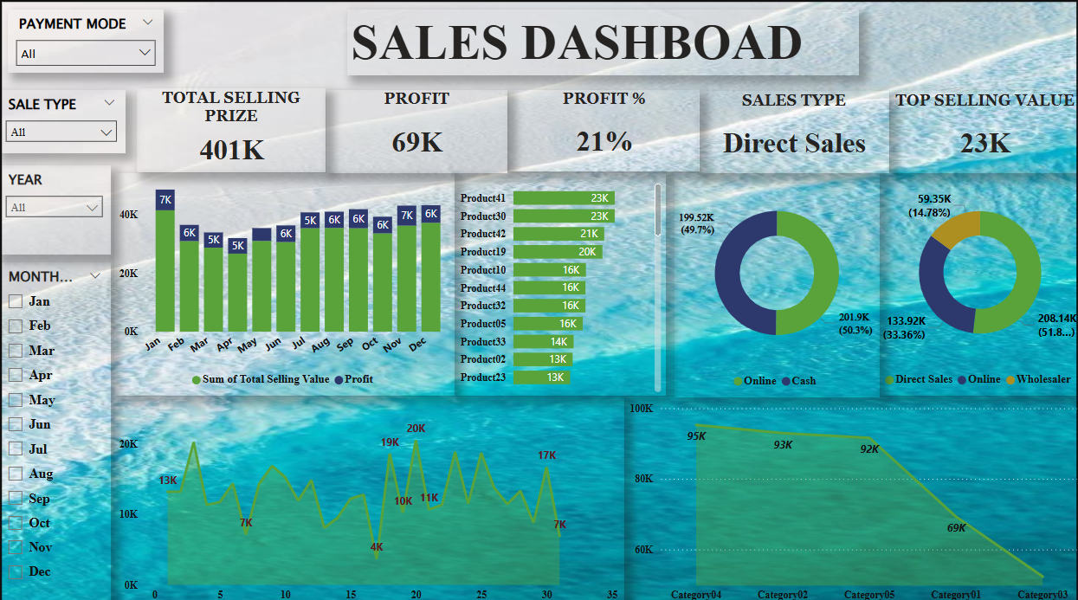

Slide 8
Key Insights:
Total Quantity Sold: 4,280 units
Total Revenue Generated: ₹401,412
Sales by Category (Quantity Sold):
Category04 – 1,198 units Category02 – 978 units
Top 2 Products by Revenue: Product41 – ₹22,952.16 Product30 – ₹22,945.92
Most Used Payment Mode: Cash
Most Common Sales Type: Direct Sales

Slide 9
Recommendations:
Products/Categories with low sales or low profit should be reviewed
Peak seasons to plan marketing and inventory
Slow periods to test new strategies or clear older stock.
Promoting digital payments with cashback or ease-of-use messaging.
Expanding the direct sales team.
Offering incentives or loyalty programs to boost repeat purchases.

Slide 10


